Slide 1
Iowa Liquor Sales
Group 4
Jonathan Beck, Henrique Cassol, Matthew Wolf, Beibarys Nyussupov

Slide 2
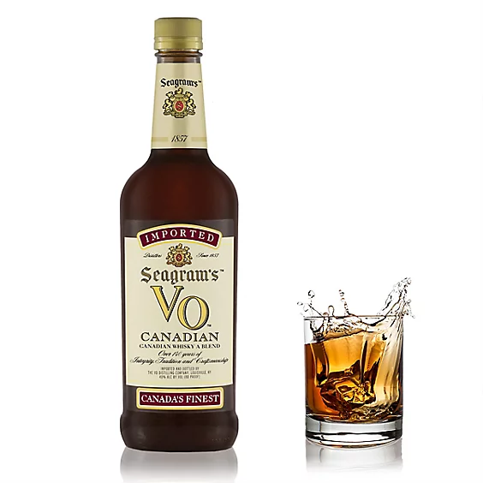

Introduction
Iowa Liquor Sales
Dataset contains 13.1 million rows (3 mil used)
Each Row represents one purchase of liquor by retailers with Class “E” liquor licensees in Iowa
grocery stores, liquor stores, convenience stores
Data stretches from Jan 1st 2012 to current
The Iowa government agency owns the dataset
Data provided by Iowa Department of Revenue, Alcoholic Beverages
Provides the state with transactional data that can be analyzed across dimensions to understand how different products and categories are selling across time, location, and customers. An analyst of this dataset will have a thorough understanding of the liquor market in Iowa.

Slide 3
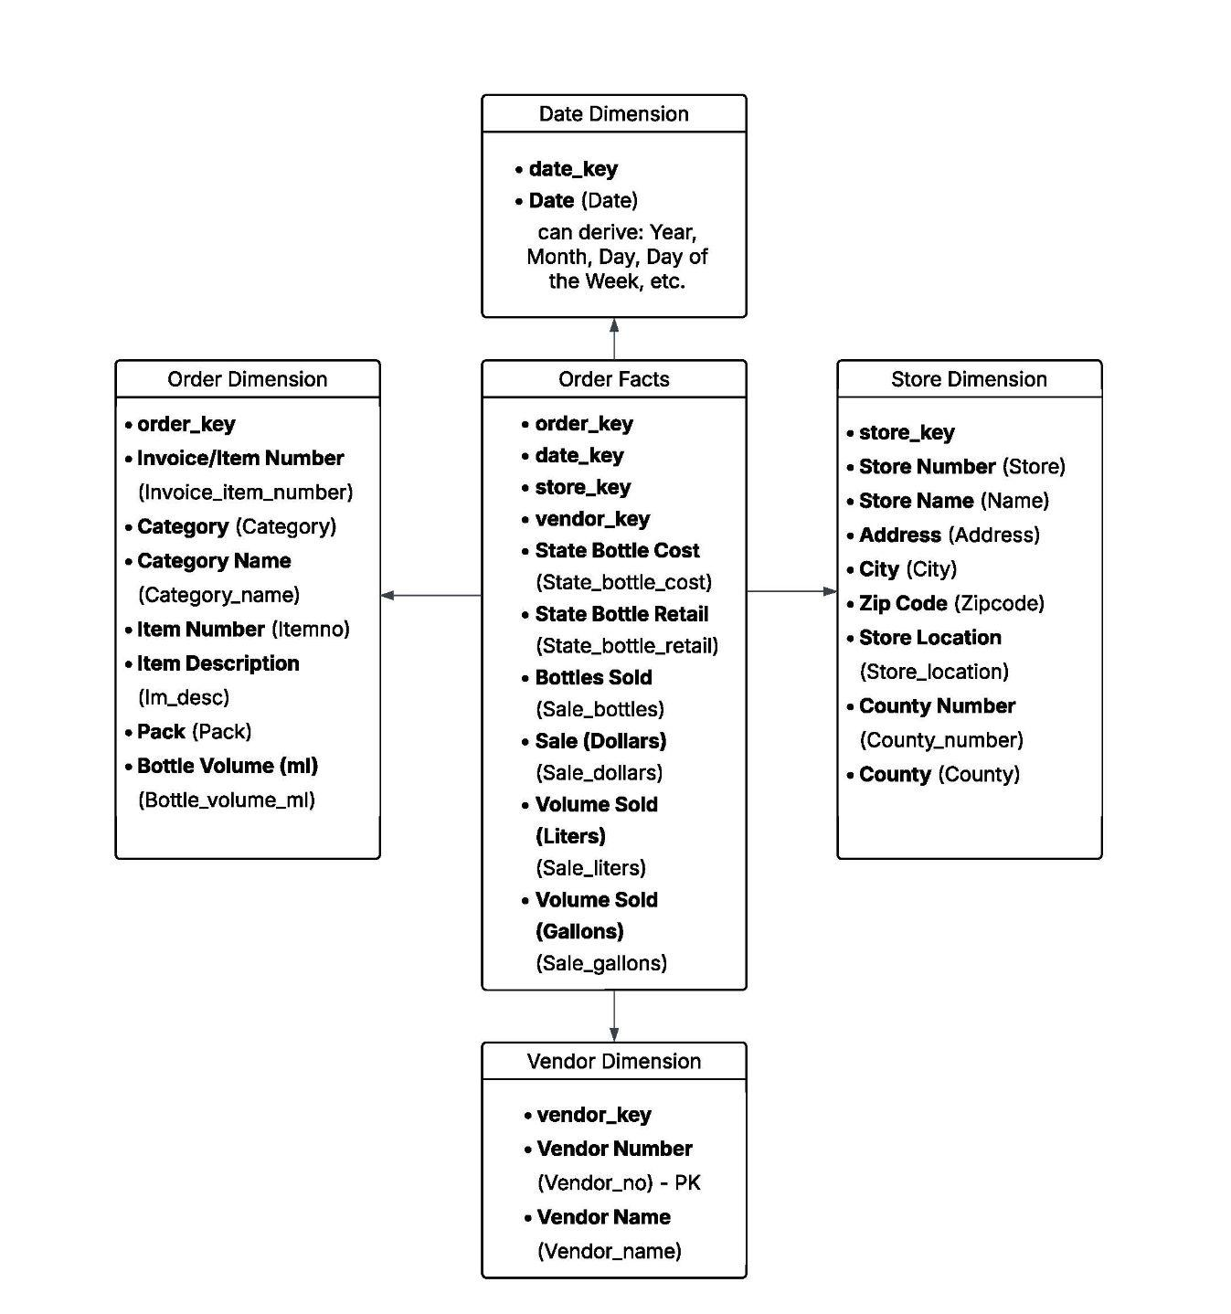
Data Wrangling & Dimensional Modeling
Dimensional Modeling:
We have 4 Dimensions in addition to facts table
Orders
Date
Store
Vendor
Data Wrangling:
3 Million Row Sample size
NA values in 3 columns based on 25k sample
Store Location, Category, and Category Name
No incorrect Data types
No duplicated rows
Derived a profit column

Slide 4
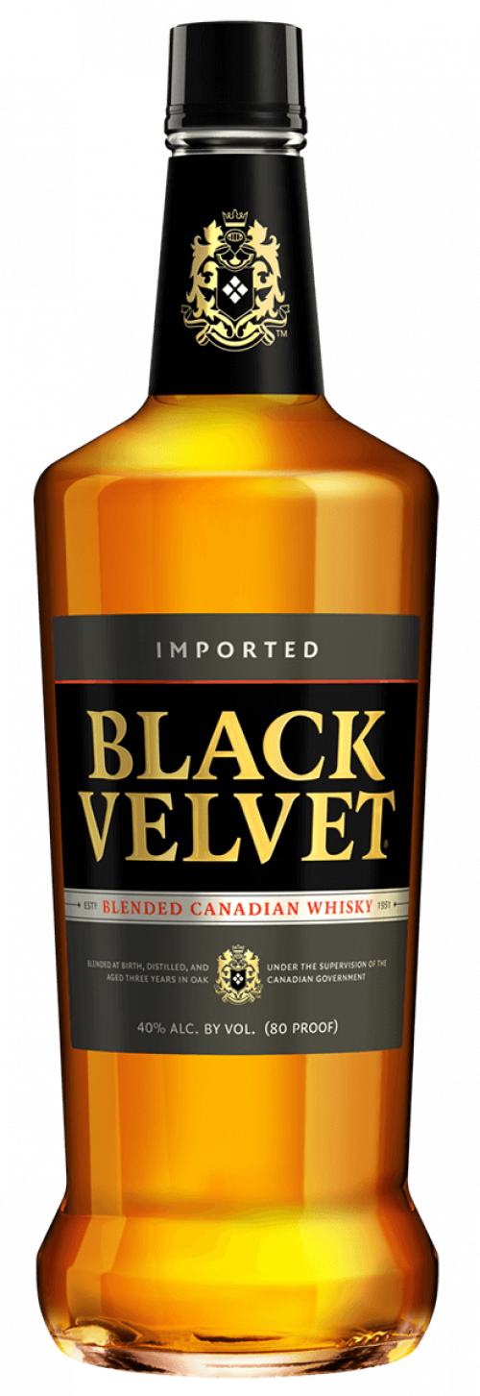
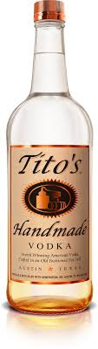
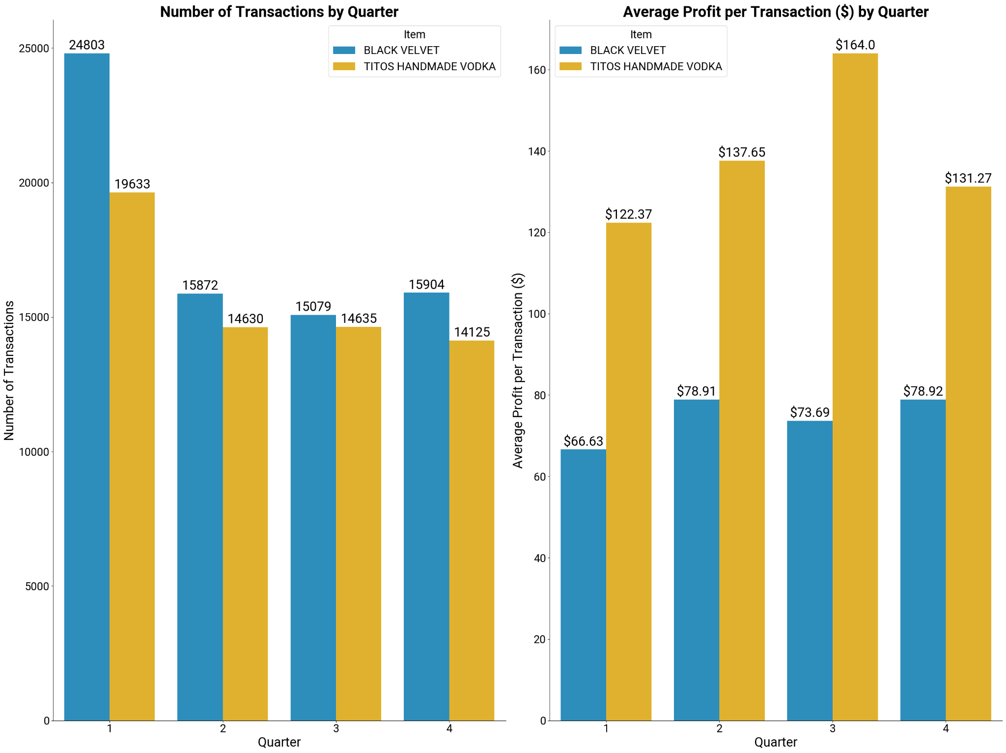
Insight #1: Top Performing Products
Top 2 Most Purchased Products: Black Velvet and Tito's Handmade Vodka
Key Finding 1: Black Velvet is purchased more frequently, especially in Quarter 1
Tito's has a much higher average profit per transaction
Recommendation: Iowa State Government should promote Tito's by reducing excise taxes, promotional licensing, partnering with state-run alcohol stores for marketing, and bundling strategies to boost sales and maintain high profit margins.

Slide 5

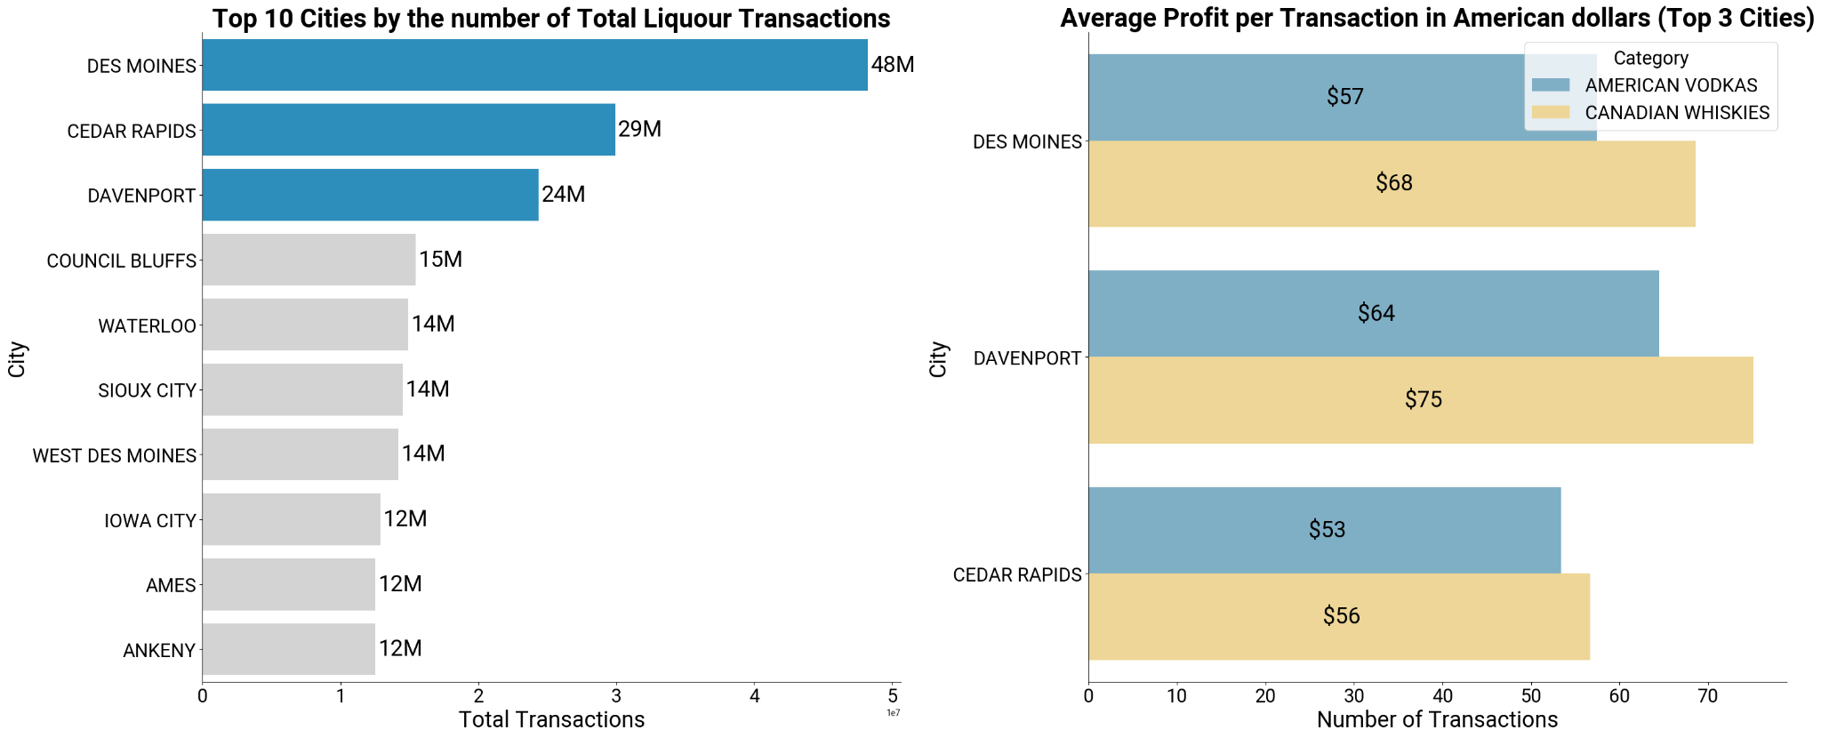
Insight #2: Best Sales Performance by Location
The Iowa State Government should use this information to ensure that they are always well stocked and can meet the high demand of alcohol for the stores in these cities.
This information can also be used to keep transportation costs down by giving the stores in these cities an incentive to buy in bulk.
Canadian Whiskeys offer much better returns relative to American Vodkas.
Canadian Whiskeys offer a higher average profit per transaction compared to American Vodka for the top three cities by alcohol sales volume.

